Slide 1








Introduction to Linux
Proudly recognized by

Slide 2
Operating System
Linux
File Structure
Linux Directories
Basic commands in Linux
Input Output Redirection
Linux Pipes
Assignment
Agenda

Slide 3
Operating System
Core software layer that manages computer hardware and provides a platform for applications to run.
Middle layer between Hardware (CPU, Memory, Disk and Network) and Applications (Browsers, Databases, IDEs, etc. )
Main responsibilities: Process Management, Memory Management, File System Management, Device Management, Security and Access Control and Networking.
Examples :
Windows
macOs
Linux
Unix

Slide 4
Linux
Open-source, Unix-like operating system kernel created by Linus Torvalds (1991).
Foundation for many complete OS distributions like Ubuntu, Debian, Fedora, CentOS, Alpine.
Powers servers, cloud systems, containers, mobile (Android), and supercomputers.
Kernel:
Core of the OS - connects hardware and software
Manages CPU, memory, process, and devices
Apps don't talk to hardware directly; they talk to the kernel thyroid system calls.
Linux vs Ubuntu
Linux = The kernel (core engine)
Ubuntu = A Linux distribution built around that kernel → adds GUI, tools, libraries, package manager (APT), and configs

Slide 5
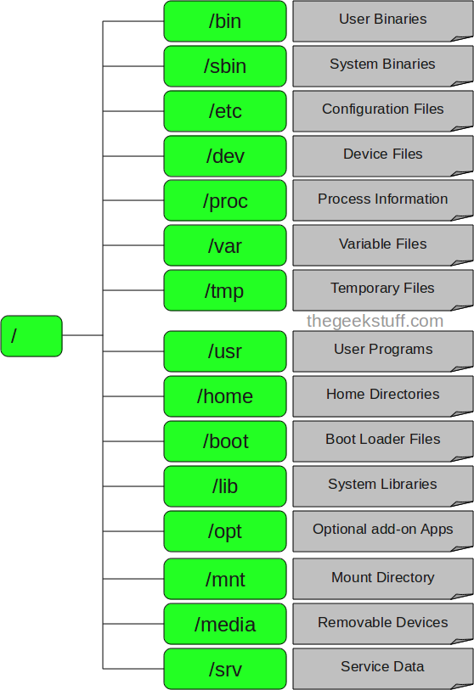
File Structure
Everything is treated as file in linux - hardware devices, configuration, running process and even sockets.
/dev/sda -> disk device
/proc/cpuinfo -> virtual file showing cpu details
/etc/passwd → text file with user information

Slide 6
Linux Directories
Directory | Purpose / Description | Example Usage
/ | Root directory — the top of the Linux file system; everything starts here. | cd /
/home | Contains user home directories (personal files, configs). | /home/ubuntu, /home/rohit
/root | Root user’s home directory (administrator). | sudo su, then cd /root
/etc | System configuration files and service settings. | /etc/ssh/sshd_config, /etc/hosts
/bin | Essential user commands available to all users. | ls, cp, mv, cat
/sbin | System binaries used for administration and maintenance. | reboot, fdisk, iptables
/usr | Installed user applications, libraries, and documentation. | /usr/bin/python3, /usr/lib/
/var | Variable data that changes often — logs, cache, spool. | /var/log/syslog, /var/lib/docker
/tmp | Temporary files; cleared on reboot. | /tmp/install.log
/dev | Device files representing hardware. | /dev/sda, /dev/null
/proc | Virtual filesystem for processes and system info. | /proc/cpuinfo, /proc/meminfo
/sys | Kernel interface to hardware devices. | /sys/class/net/eth0
/media | Auto-mounted removable media (USBs, external drives). | /media/ubuntu/USB
/mnt | Manual mount point for temporary drives. | /mnt/mydisk
/opt | Optional / third-party software installations. | /opt/google/chrome
/run | Runtime data for system processes after boot. | /run/systemd/

Slide 7
Basic commands in Linux
cd
To navigate through the Linux files and directories, use the cd command. Depending on your current working directory, it requires either the full path or the directory name.
cd /home/username/Movies
Here are some shortcuts to help you navigate:
cd ~[username] goes to another user’s home directory.
cd .. moves one directory up.
cd- moves to your previous directory.
pwd:
The command “pwd” (print working directory), prints the current working directory with full path name from terminal.
For example, if we are user directory john then pwd will print: /home/john.

Slide 8
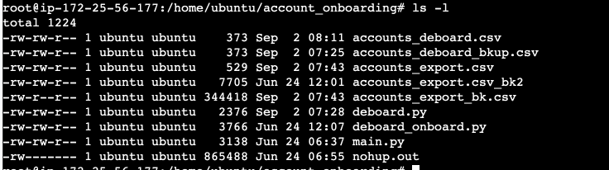
Basic commands in Linux
ls
The ls command lists files and directories within a system. Running it without a flag or parameter will show the current working directory content.
ls : The command “ls” stands for (List Directory Contents), List the contents of the folder
ls -a : Command “ls -a“, list the content of folder, including hidden files starting with ‘.’
ls -l :The command “ls -l” list the content of folder, in long listing fashion

Slide 9
Basic commands in Linux
touch:
The touch command creates an empty file or generate and modify a timestamp if the file already exist in the directory. → touch abc.txt
cat
The “cat” stands for (Concatenation). Concatenate (join) two or more plain file and/or print contents of a file on standard output. → cat abc.txt
Here are other ways to use the cat command:
cat > filename.txt → creates a new file.
cat filename1.txt filename2.txt > filename3.txt → merges filename1.txt and filename2.txt and stores the output in filename3.txt

Slide 10
Basic commands in Linux
rm
The rm command is used to delete files within a directory. By default, it does not remove directories. rm filename1 filename2 filename3
Here are some acceptable options you can add:
rm -i: filename : Prompt before every removal.
rm -f: forcefully remove files and never ask
rm -r: Remove directories and their contents recursively.
man
The man command provides a user manual of any commands or utilities you can run in Terminal, including the name, description, and options.
For example, you want to access the manual for the ls command: man ls

Slide 11
Basic commands in Linux
cp
Use the cp command to copy files or directories and their content. Take a look at the following use cases.
To copy files to a directory, enter the file names followed by the destination directory: cp filename1.txt filename2.txt filename3.txt /home/username/Documents
To copy the content of a file to a new file in the same directory, enter cp followed by the source file and the destination file: cp filename1.txt filename2.txt
To copy an entire directory, pass the -R flag before typing the source directory, followed by the destination directory: cp -R /home/username/Documents /home/username/Documents_backup
mv
The primary use of the mv command is to move and rename files and directories.
For example, you want to move filename.txt to the /home/username/Documents directory: mv filename.txt /home/username/Documents
You can also use the mv command to rename a file: mv old_filename.txt new_filename.txt

Slide 12
Basic commands in Linux
mkdir
Use the mkdir command to create one or multiple directories at once and set permissions for each of them.
For example, you want to create a directory called Music: mkdir Music
To make a new directory called Songs inside Music, use this command: mkdir Music/Songs
If a directory doesn't exist (e.g. Movie) then run following command and it will create all the folders mkdir -p Movie/Songs/latest
The mkdir command accepts many options, such as:
-p or –parents create a directory between two existing folders. For example, mkdir -p Music/2020/Songs will make the new “2020” directory.
-m sets the file permissions. For instance, to create a directory with full read, write, and execute permissions for all users, enter mkdir -m777 directory_name.
-v prints a message for each created directory. (-v means verbose)

Slide 13
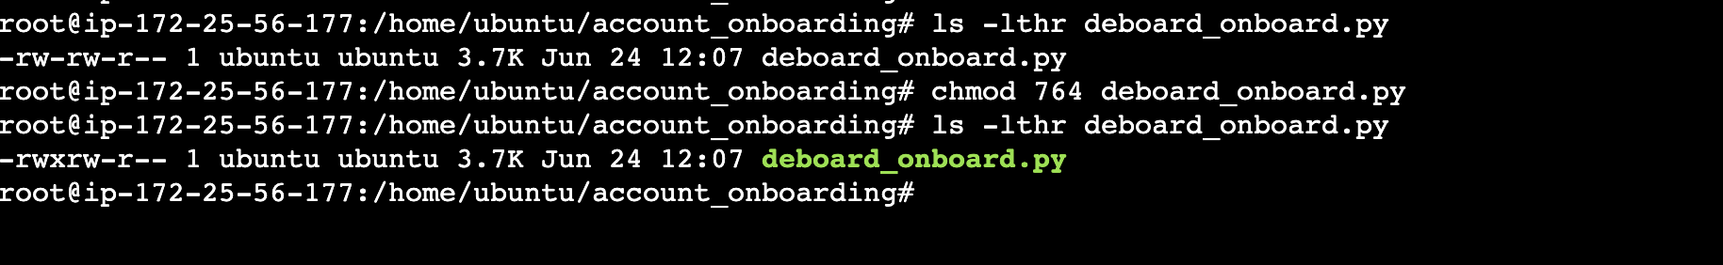
Basic commands in Linux
chmod
chmod is a common command that modifies a file or directory is read, write, and execute permissions.
In Linux, each file is associated with three user classes – owner, group member, and others.
Read (r) = 4
Write (w) = 2
Execute (x) = 1

Slide 14
Basic commands in Linux
wc
The wc (word count) command in Unix/Linux operating systems is used to find out number of lines, word count, byte and characters count in a files specified by the file arguments. wc state.txt
Here are some acceptable options to add:
wc -l : Prints the number of lines in a file.
wc -w : prints the number of words in a file.
wc -c : Displays the count of bytes in a file.
head
The head command allows you to view the first ten lines of a text. Adding an option lets you change the number of lines shown.
head note.txt
Here are some acceptable options to add:
-n or –lines prints the first customized number of lines. For example, enter head -n 5 filename.txt to show the first five lines of filename.txt.
-c or –bytes prints the first customized number of bytes of each file.

Slide 15
Basic commands in Linux
tail
The tail command displays the last ten lines of a file. It allows users to check whether a file has new data or to read error messages
For example, you want to show the last 20 lines of the colors.txt file:
tail -n20 colors.txt
The -f option “which stands for follow” will keep the stream going. This command will keep the file open to display updated changes to console until the user breaks the command.
tail -f /var/log/apache2/access.log
less
The less command is a Linux terminal pager that shows a file's contents one screen at a time. It is useful when dealing with a large text file because it doesn't load the entire file but accesses it page by page, resulting in fast loading speeds.
less /etc/updatedb.conf
Here are some acceptable options to add:
less -N /etc/init/mysql.conf - Show Line Number with content.
less +G /var/log/messages - Opens the file in reverse order.

Slide 16
Basic commands in Linux
tar
The tar command archives multiple files into a TAR file – a common Linux format similar to ZIP, with optional compression. If user wants to tar the folder Documents, then run:
tar -cvf newarchive.tar /home/user/Documents
The tar command accepts many options, such as:
-x extracts a file. (E.g. tar –xvzf documents.tar.gz)
-t lists the content of a file. (E.g. tar –tzf documents.tar.gz)
-u/-r archives and adds to an existing archive file. (E.g. tar –rzf documents.tar.gz /home/user/Documents/abc.txt)
grep
It stands for "global regular expression print," processes text line by line and prints any lines which match a specified pattern.
For example, you want to search for the word blue in the notepad.txt file:
grep blue notepad.txt
Here are some acceptable options to add:
grep -i "boo" /etc/passwd #You can force grep to ignore word case
grep -r "192.168.1.5" /etc/ #You can search recursively
grep -c "Linux" welcome.txt #You can count the total number of lines where the string pattern appears

Slide 17
Basic commands in Linux
du
If you want to check how much space a file or a directory takes up, use the du command. You can run this command to identify which part of the system uses the storage excessively. Remember, you must specify the directory path when using the du command.
For example, to check /home/user/Documents enter: du /home/user/Documents
Adding a flag to the du command will modify the operation, such as:
-s offers the total size of a specified folder.
-m provides folder and file information in MB.
-k displays information in KB.
df
Use the df command to report the system’s disk space usage, shown in percentage and kilobyte (KB). For example, enter the following command if you want to see the current directory’s system disk space usage in a human-readable format:
df -h
These are some acceptable options to use:
df -m displays information on the file system usage in MBs.
df -k displays file system usage in KBs.

Slide 18
Basic commands in Linux
sudo: Short for superuser do, sudo is one of the most popular basic Linux commands that lets you perform tasks that require administrative or root permissions. sudo (command)
su: The switch user or su command allows you to run a program as a different user. It changes the administrative account in the current login session.
su user_name
whoami: When running whoami without any options, the output shows the name of the currently logged-in user. whoami
alias, unalias: alias allows you to create a shortcut with the same functionality as a command, file name, or text. When executed, it instructs the shell to replace one string with another.
alias list='ls -la'
To remove the assigned value to the alias use: unalias list

Slide 19
Basic commands in Linux
history With history, the system will list up to 500 previously executed commands, allowing you to reuse them without re-entering. Keep in mind that users only see the their own executed commands so switch users to see different commands.
history
curl The simplest use of cURL is to display the contents of a page. The example will render the home web page of domain.com. curl domain.com Below is an example of how to retrieve header information from a website. curl -I www.domain.com
wget
The Linux command line lets you download files from the internet using the wget command.
For example, enter the following command to download the latest version of WordPress:
wget https://wordpress.org/latest.zip

Slide 20
Input /Output Redirection
Redirection : changing where a command reads input from or sends output to. By default input comes from keyboard and output goes to screen. With redirection you can
Send output to a file
Read input from a file
Combine or Suppress output
Output Redirection
Input Redirection
Operator | Description | Example | Explanation
> | Redirect output to a file (overwrite) | ls > files.txt | Saves list of files into files.txt
>> | Redirect output and append | echo "Hello" >> log.txt | Adds to existing log.txt
2> | Redirect errors (stderr) | ls /abc 2> errors.txt | Saves error message only
&> | Redirect both output & errors | command &> output.txt | Combines stdout and stderr
Operator | Description | Example
< | Take input from a file | sort < names.txt
<< | “Here document” — read input until a delimiter

Slide 21
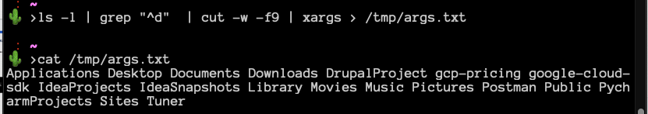
Piping Commands
Pipe : The pipe operator (|) connects the output of one command to the input of another —allowing you to chain commands to process data efficiently.
Combining Pipes and Redirection

Slide 22
Assignment
Find and terminate the top memory-consuming process on your system.
Create a user named devops and grant them sudo privileges.
Connect to a remote server, create a directory, and copy files into it using SCP.
List all active processes and save only those containing the word java into a file.
Generate an SSH key pair and configure it for two different remote servers.
Find all lines containing “error” in /var/log/syslog and redirect them to errors_found.txt
Find all .conf files in /etc, sort them alphabetically, and save to conf_list.txt.
Display the total number of unique shell types listed in /etc/passwd and save to shell_count.txt
Explore vi/vim for Creating a text file. Understand cursor movement, switching input mode (append, insert etc), deleting command, pasting content, undo , redo ,search , save and quit operations in vim.
Reset the current user password and reboot the system form shell.
Zip the content of your home directory via tar and send it via scp to other person laptop. Unzip the content on other person laptop via tar.
Install and setup application via apt - mysql, postman, docker, dbeaver

Slide 23
Thank You

